Slide 1
Identifying and explaining suicide, homicide, and overdose hotspots in Arizona
Plus, an AZ-VDRS dashboard presentation
By Jordan Batchelor, Laura Lightfoot, and Charles M. Katz

Slide 2





Research project team
Jordan Batchelor, PhD
Laura Lightfoot
Charles M Katz, PhD
Christi L Gullion, PhD
Research Analyst
Center for Violence Prevention and Community Safety
PhD Candidate
School of Criminology & Criminal Justice
Professor and Director
School of Criminology & Criminal Justice, Center for Violence Prevention and Community Safety
Assistant Professor
University of Texas at Arlington, School of Criminology & Criminal Justice

Slide 3


Introduction to AZ-VDRS, AZ-SUDORS
The CVPCS manages¹ the following two surveillance systems:
Participation in NVDRS in 2015
Primarily homicides, suicides, legal intervention deaths
Death certificates, medical examiner reports, law enforcement reports
Participation in SUDORS in 2020
Primarily unintentional overdose events
Death certificates, medical examiner reports, toxicology reports
¹CVPCS is the bone fide agent for AZ-VDRS and sub-contracted through Arizona Department of Health Services for AZ-SUDORS

Slide 4
Presentation Outline
Part 1. Homicide, suicide, and overdose hotspot study
Part 2. AZ-VDRS data dashboard demonstration
Part 3. Q&A (if time permits)

Slide 5
Identifying and explaining homicide, suicide, and overdose hotspots in Arizona

Slide 6
Background
Impact on Public Health Systems: These crises strain public health systems, law enforcement, and social services, requiring urgent intervention (Ehlman, 2022).
Interconnected Public Health Challenges
Homicide/suicide/overdose leading causes of death in US (CDC, 2022)
Arizona has 18th highest highest fatal unintentional overdose rate, 14th highest homicide rate, and 12th highest suicide rate
But little is known about where these crisis overlap or are unique

Slide 7
Background
Impact on Public Health Systems: These crises strain public health systems, law enforcement, and social services, requiring urgent intervention (Ehlman, 2022).
Interconnected Public Health Challenges
Spatial clustering of manners of death
Homicide/suicide/overdose leading causes of death in US (CDC, 2022)
Arizona has 18th highest highest fatal unintentional overdose rate, 14th highest homicide rate, and 12th highest suicide rate
But little is known about where these crisis overlap or are unique
These risk are not evenly distributed (Zhang & Monnat, 2024)
Clusters found in US South (homicide), West (suicide), and Appalachia (overdose) (Amin et al., 2021; Monnat, 2018)
Rural areas may increase social isolation resulting in more suicide, while urban areas offer greater substance availability (Rosenfeld et al., 2021)

Slide 8
Background
Impact on Public Health Systems: These crises strain public health systems, law enforcement, and social services, requiring urgent intervention (Ehlman, 2022).
Predictors and risk factors
Social, economic, and environmental factors impact risk of suicide/homicide/overdose, with socioeconomic disadvantage and access to resources key (Chichester et al., 2020; Sampson, 2003)
But little is known about where these crisis overlap or are unique

Slide 9
Background
Impact on Public Health Systems: These crises strain public health systems, law enforcement, and social services, requiring urgent intervention (Ehlman, 2022).
Predictors and risk factors
Social, economic, and environmental factors impact risk of suicide/homicide/overdose, with socioeconomic disadvantage and access to resources key (Chichester et al., 2020; Sampson, 2003)
Study aims
But little is known about where these crisis overlap or are unique
Identify suicide, homicide, and overdose hotspots in Arizona, 2020-2023
Examine relationship between counts of deaths within regions and several socio-structural predictors

Slide 10






Methods: Overview
Collect data
Create FIPS codes
Identify variables
Link variables to data
Find hotspots
Analyze variables

Slide 11

Methods: Data collection
Collect data. Nearly all suicides, homicides, and fatal unintentional overdoses in Arizona, 2020-2023
Create FIPS codes. Created tract-level FIPS codes from data
Identify variables. Reviewed, identified 15 independent variables
Link variables to data. Retrieved variables from US Census Bureau’s American Community Survey 5-year estimates
1,699 tracts, 2020-2023
9,125 overdoses
5,552 suicides
1,925 homicides

Slide 12
Methods: Analyses
Find hotspots.
Compute incidence rates for manners of death separately
Smooth rates with Empirical Bayes method
Local Indicators of Spatial Autocorrelation (Anselin, 1995)
Identify tracts labelled as High-High according to LISA
Analyze independent variables.
Perform Principal Component Analysis to reduce variables
Perform separate negative binomial regressions

Slide 13
Findings: Hotspots
Suicides Homicides Unintentional overdoses
Deep red = HH; light red = HL; deep blue = LL; light blue = LH; light gray = non-significant

Slide 14
Findings: Hotspots: Maricopa County
Suicides Homicides Unintentional overdoses
Deep red = HH; light red = HL; deep blue = LL; light blue = LH; light gray = non-significant

Slide 15
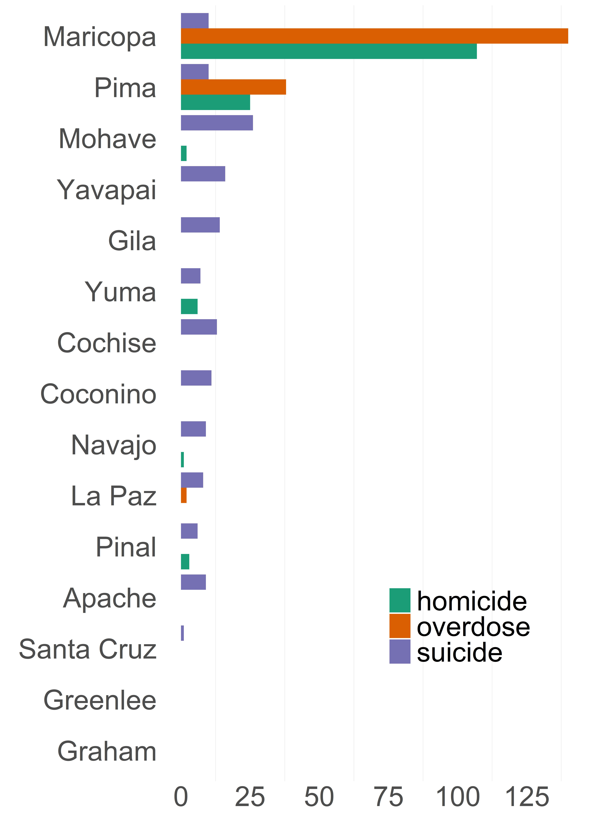
Findings: Hotspots
Number of hotspot tracts by county
About ten percent of tracts classified as hotspots
Suicide hotspots: n=162, 9.5%, 48.2 per 100,000
Homicide hotspots: n=172, 10.1%, 24.1 per 100,000
Overdose hotspots: n=180, 10.6%, 101 per 100,000
A total of 396 tracts identified as a hotspot
281 tracts hotspots for a single manner of death
112 tracts hotspots for two manners of death
3 tracts hotspots for all three manners of death

Slide 16
Findings: Regression analyses
Three regression analyses
Dependent variable → count of deaths for a given manner
Independent variables → 4 components plus 2 other variables
Hispanic and immigrant communities (Comp. #1)
Residential instability in young, urban communities (Comp. #2)
Residential stability in young, diverse communities (Comp. #3)
Concentrated disadvantage (Comp. #4)

Slide 17
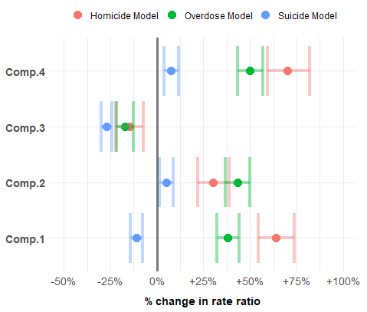
Findings: Regression analyses
Example: For a one unit increase in Comp.4, the homicide rate increases by 64%
Increases all rates
(Concentrated disadvantage)
Decreases all rates
(Resident. stability, young, diverse)
Independent variables
(Resident. instability, young, urban)
Mixed effect on rates
(Hispanic, immigrant communities)
Percent change in incidence rate

Slide 18
Implications and future directions
Spatial clustering of violent deaths, fatal overdoses
Finding: Suicides, homicides, and fatal unintentional overdoses in Arizona not evenly distributed across space
Implication: Prevention efforts targeting hotspots may make greatest impact
Future research: Identify hotspots, cold-spots using smaller geographies (e.g., blocks, neighbors, streets)

Slide 19
Implications and future directions
Distinct and overlapping hotspots
Finding: Most hotspots linked to one manner of death, but homicide + overdose hotspots often overlapped
Implication: Prevention efforts targeting overlapping hotspots may make greatest impact
Future research: Investigate temporal trends in AZ hotspots

Slide 20
Implications and future directions
Broadly significant risk factors
Finding: Certain risk factors uniformly associated with increased/decreased risk for all manners of death
Implication: Policies targeting economic stability, housing security may have overarching impacts
Future research: Examine micro-level risk factors, including those addressing suicide risk

Slide 21
An AZ-VDRS dashboard demonstration

Slide 22
AZ-VDRS Dashboard
Faculty and staff at the Center for Violence Prevention and Community Safety seek to collect timely, accurate, and complete data on Arizona’s violent deaths
The next question is, what can we do with the data? How can we use it to inform the public?

Slide 23
AZ-VDRS Dashboard
Led us to building public-facing dashboard for displaying AZ-VDRS data in summer 2024, with update as of January 2025
Goal to display accurate, comprehensive AZ-VDRS data that may be useful to media, researchers, and members of public
View at azvdrs.org/dashboard

Slide 24
Closing slide
Thank you for coming
Contact us
Jordan Batchelor
jordan.batchelor@asu.edu
Laura Lightfoot
lllightf@asu.edu
Charles M. Katz
CHARLES.KATZ@asu.edu
Visit us at cvpcs.asu.edu or azvdrs.org

Slide 25
References

Slide 26
Amin, R., Yang, H., & Lynch, M. J. (2021). Mapping homicide clusters across the United States using county-level data, 2004–2012 with comparisons to earlier studies. Deviant Behavior, 42(2), 210–231.
Anselin, L. (1995). Local indicators of spatial association—LISA. Geographical Analysis, 27(2), 93-115.
Centers for Disease Control and Prevention. (2022). National vital statistics system – Mortality data. CDC WONDER.
Chichester, K., Drawve, G., Sisson, M., McCleskey, B., Dye, D. W., & Cropsey, K. (2020). Examining the neighborhood-level socioeconomic characteristics associated with fatal overdose by type of drug involved and overdose setting. Addictive Behaviors, 111, 106555.
Monnat, S. M. (2018). Factors associated with county-level differences in US drug-related mortality rates. American Journal of Preventive Medicine, 54(5), 611-619.
Rosenfeld, R., Wallman, J., & Roth, R. (2021). The opioid epidemic and homicide in the United States. Journal of Research in Crime and Delinquency, 58(5), 545–590.
Sampson, R. J. (2003). The neighborhood context of well-being. Perspectives in Biology and Medicine, 46(3), S53–S64.
Zhang, X., & Monnat, S.M. (2024). Geographically specific associations between county-level socioeconomic and household distress and mortality from drug poisoning, suicide, alcohol, and homicide among working-age adults in the United States. SSM – Population Health, 25.

Slide 27
Extra materials

Slide 28
Extra materials
County | # of tracts
Maricopa | 972
Pima | 263
Pinal | 93
Yavapai | 72
Mohave | 66
Yuma | 61
Coconino | 37
Cochise | 35
Navajo | 35
Apache | 18
Gila | 16
La Paz | 10
Santa Cruz | 10
Graham | 8
Greenlee | 3
Total | 1,699

Slide 29
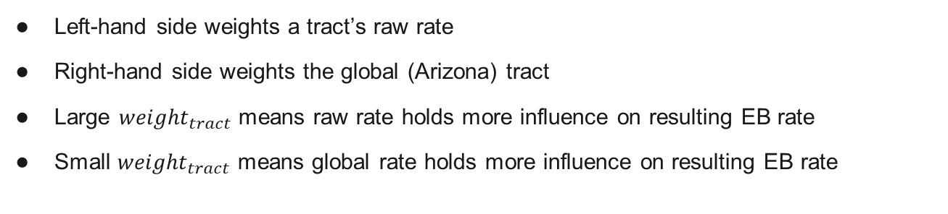
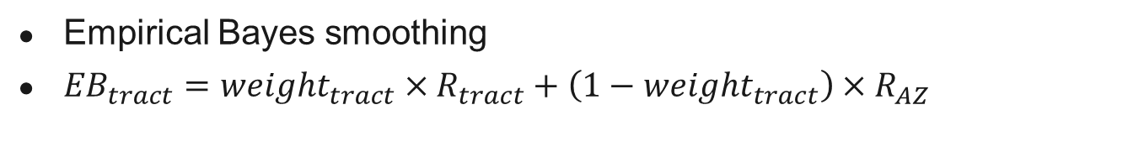
Extra materials
Empirical Bayes smoothing
${EB}_{tract}={weight}_{tract}×R_{tract}+\left(1−{weight}_{tract}\right)×R_{AZ}$
      Left-hand side weights a tract’s raw rate
      Right-hand side weights the global (Arizona) tract
      Large ${weight}_{tract}$ means raw rate holds more influence on resulting EB rate
      Small ${weight}_{tract}$ means global rate holds more influence on resulting EB rate

Slide 30
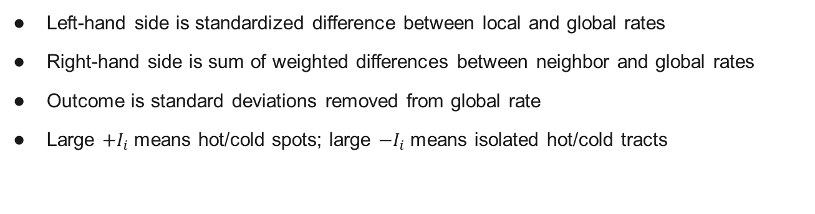
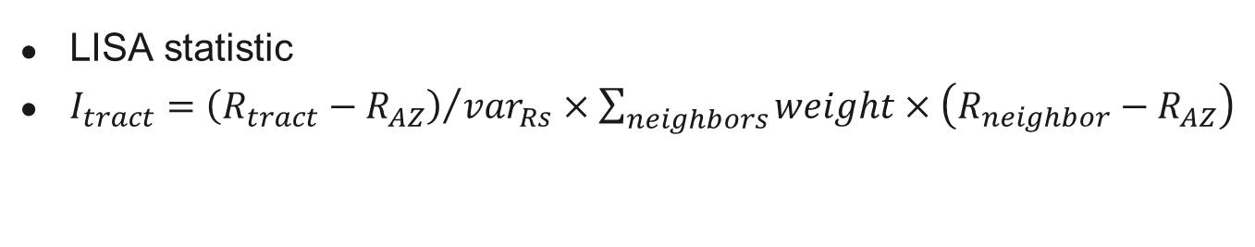
Extra materials
LISA statistic
$I_{tract}={\left(R_{tract}−R_{AZ}\right)}/{{var}_{Rs}}×\sum_{neighbors}{weight×\left(R_{neighbor}−R_{AZ}\right)}$
      Left-hand side is standardized difference between local and global rates
      Right-hand side is sum of weighted differences between neighbor and global rates
      Outcome is standard deviations removed from global rate
      Large ${+I}_{i}$ means hot/cold spots; large ${−I}_{i}$ means isolated hot/cold tracts

Slide 31
Extra materials
 | Suicide |  | Homicide |  | Unintentional overdose
 | N (%) | Rate | N (%) | Rate | N (%) | Rate
NS | 1,276 (75.1) | 18.7 | 1,201 (70.7) | 5.8 | 1,109 (65.3) | 29.5
LL | 162 (9.5) | 9.2 | 249 (14.7) | 1 | 369 (21.7) | 9.8
LH | 63 (3.7) | 12.9 | 60 (3.5) | 2.6 | 25 (1.5) | 23.5
HL | 36 (2.1) | 28.1 | 17 (1) | 11.9 | 16 (0.9) | 52.2
HH | 162 (9.5) | 48.2 | 172 (10.1) | 24.1 | 180 (10.6) | 101

Slide 32
Extra materials
Variables | Comp. 1 | Comp. 2 | Comp. 3 | Comp. 4
Foreign-born population (%) | 0.88
Hispanic population (%) | 0.84
Males >24 years old with less than a high school degree (%) | 0.83
Population that changed residence in past year (%) |  | 0.86
Renter-occupied housing (%) |  | 0.78
Males aged 15-29 (%) |  | 0.65
Population density |  | 0.48
Vacant homes (%) |  |  | -0.88
Population >64 years old (%) |  |  | -0.72
African American population (%) |  |  | 0.43
Unemployed population (%) |  |  |  | 0.82
Population living in poverty (%) |  |  |  | 0.67
Families with a female head and children <18 years old (%) |  |  |  | 0.52

Slide 33
Extra materials
 | Males >24 w/o H.S. dipl | Families w/ female head and children | Foreign-born pop | Renter-occupied housing | Poverty | Black pop | Hispanic pop | Unemployed pop | Males 15-29 y.o. | People 65+ y.o. | Vacant homes | Pop changing residence in past year | Population density
Comp.1 | 0.83 | 0.37 | 0.88 | 0.23 | 0.39 | 0.14 | 0.84 | 0.08 | 0.11 | -0.17 | -0.09 | -0.12 | 0.42
Comp.2 | 0.00 | 0.38 | 0.12 | 0.78 | 0.33 | 0.40 | 0.06 | 0.00 | 0.66 | -0.24 | 0.07 | 0.86 | 0.48
Comp.3 | -0.03 | 0.23 | 0.18 | 0.11 | -0.23 | 0.43 | 0.23 | 0.12 | 0.32 | -0.72 | -0.88 | -0.09 | 0.42
Comp.4 | 0.41 | 0.52 | -0.01 | 0.32 | 0.67 | 0.08 | 0.24 | 0.82 | 0.34 | -0.35 | 0.08 | -0.06 | -0.09

Slide 34
Extra materials
Independent variable | Suicide | Homicide | Overdose
 | RR (95% CI) | RR (95% CI) | RR (95% CI)
Component #1 | 0.89 (0.86, 0.93)*** | 1.64 (1.54, 1.74)*** | 1.38 (1.32, 1.44)***
Component #2 | 1.05 (1.01, 1.09)** | 1.3 (1.22, 1.39)*** | 1.43 (1.37, 1.5)***
Component #3 | 0.73 (0.7, 0.76)*** | 0.85 (0.78, 0.93)*** | 0.83 (0.78, 0.87)***
Component #4 | 1.08 (1.04, 1.12)*** | 1.7 (1.59, 1.82)*** | 1.5 (1.43, 1.57)***
Group quarters | 1.01 (1.01, 1.01)*** | 1.01 (1, 1.01) | 1.01 (1.01, 1.02)***
Public assistance | 1.01 (0.99, 1.02) | 1.02 (0.99, 1.05) | 1.02 (1, 1.05)*
Note: * indicates significance at <0.05 level; ** indicates significance at <0.01 level; *** indicates significance at <0.001 level

