Slide 1


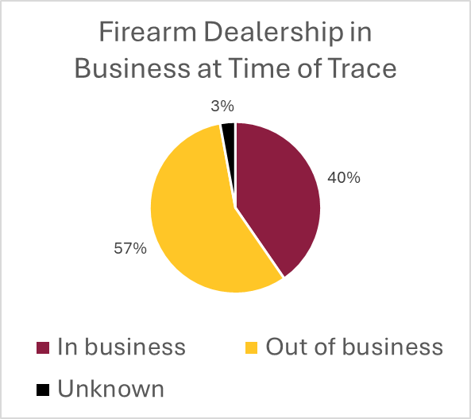
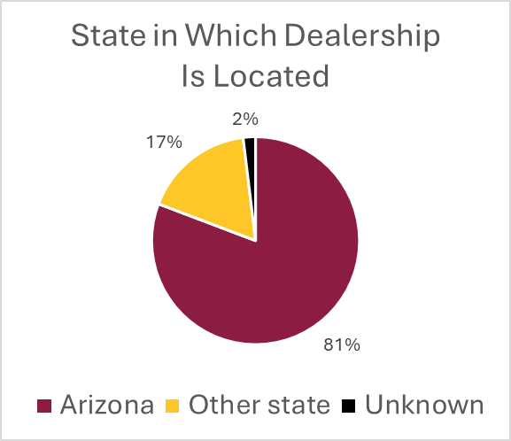
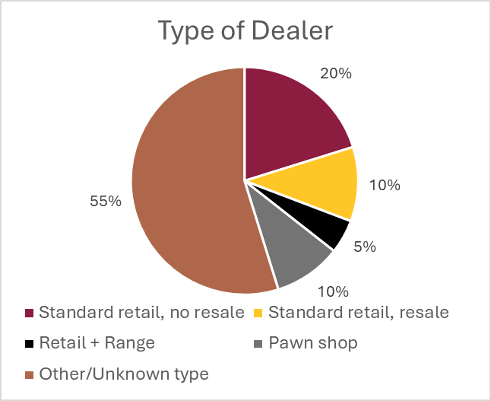
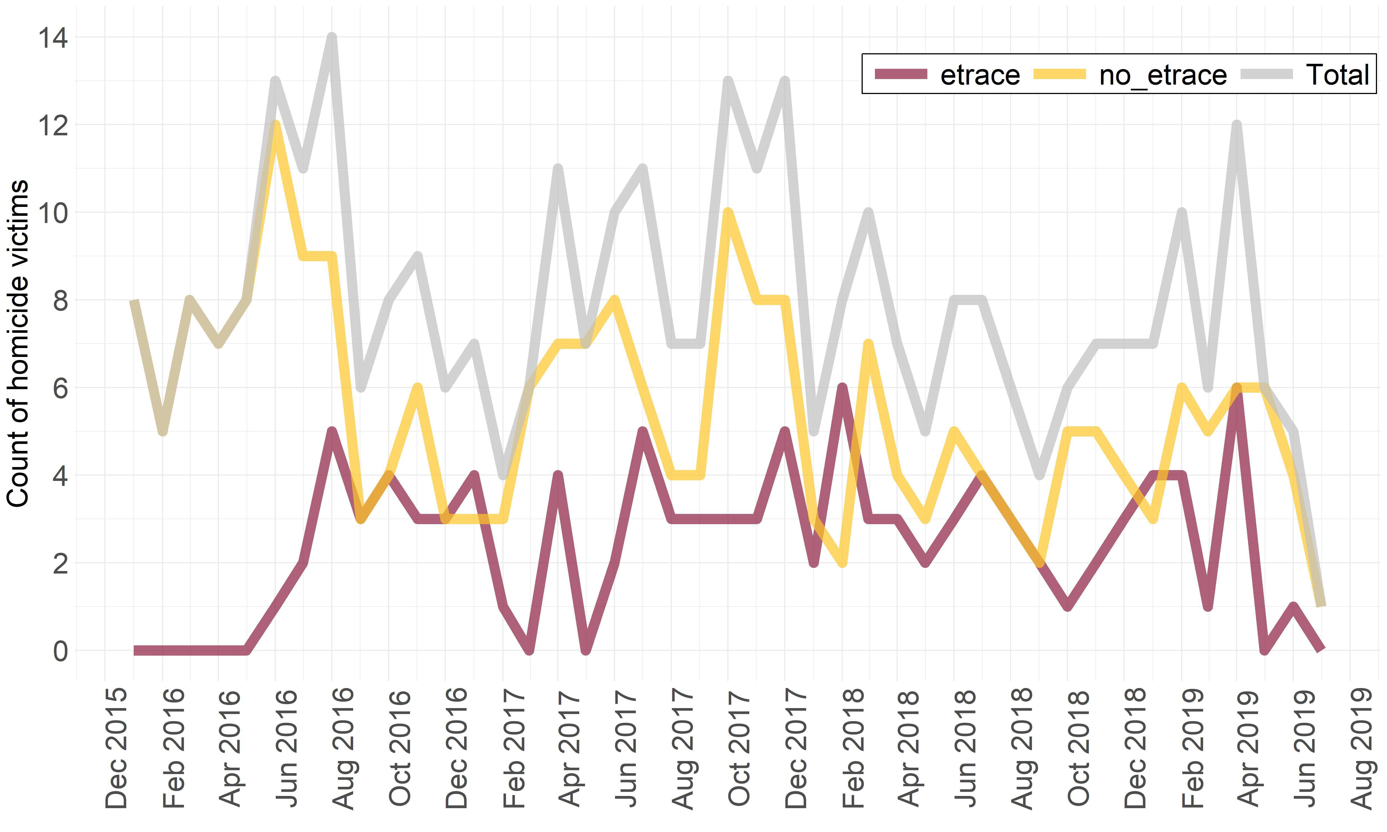
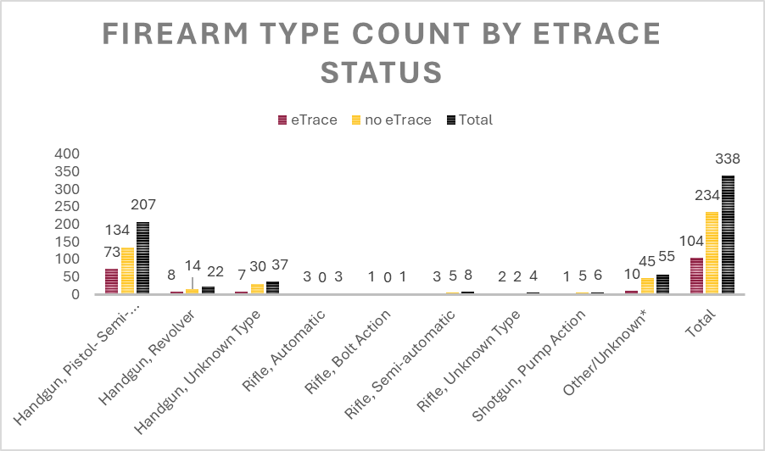
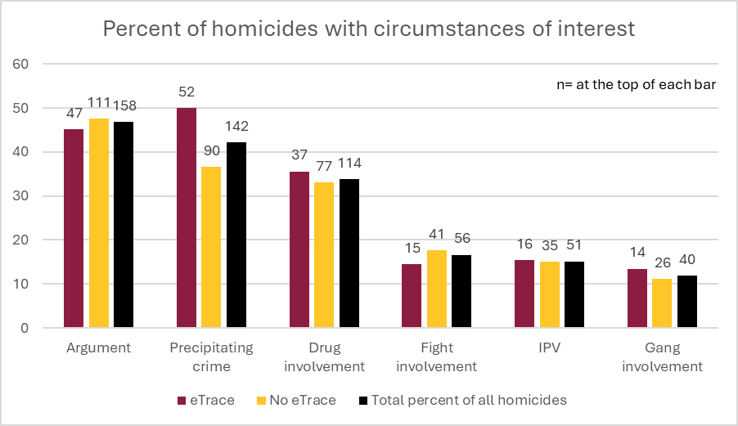
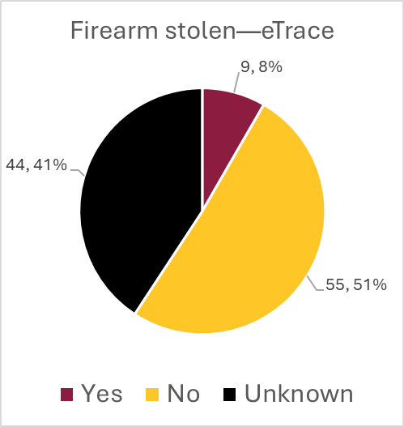
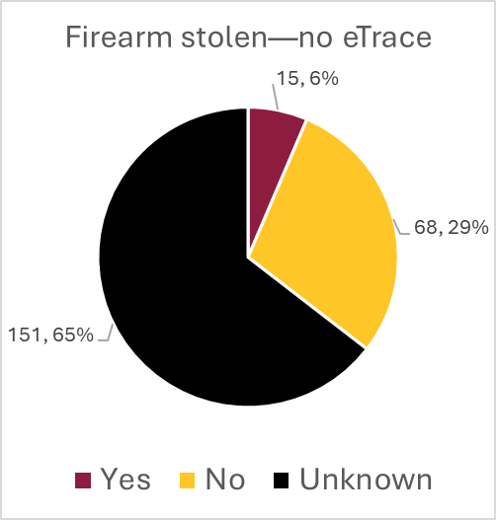

Analyzing the Origin Characteristics of Firearms Recovered From Violent Death Incidents Using ETrace Data
Taylor Cox, PhD, Charles Katz, PhD, and Jordan Batchelor, PhD
Center for Violence Prevention and Community Safety, Arizona State University
Background
Methodology
Data on homicides that occurred in Phoenix, Arizona, from 2015 to 2020 derived from the Arizona Violent Death Reporting System (AZ-VDRS) were compared to eTrace results from traces run by the Phoenix Police Department in Maricopa County, Arizona, between October 1, 2016, and September 30, 2019, to examine the associated characteristics.
ETrace results from October 2016 through September 2019 were obtained from the Phoenix Police Department and matched against AZ-VDRS homicide decedents using law enforcement record numbers to derive eTrace status and dealer-related information. AZ-VDRS incident information derived from the CDC’s National Violent Death Reporting System database was then matched on those results using AZ-VDRS ID number to calculate descriptive statistics for eTrace results by demographics, circumstances, and firearm information. Both descriptive statistics and statistical testing were adopted. For statistical testing, chi-square tests of independence were run to examine the association between demographic categories and precipitating circumstances with eTrace results.
Findings
Dealer information
Firearm tracing and trends
Most homicides did not involve successfully traced firearms.
Traced firearms peaked at six in Feb 2018 and Apr 2019.
Non-traced firearms peaked at 12 in Jun 2016.
Semi-automatic pistols were the most common firearm overall and among traced cases.
Demographics
Black decedents: Slightly higher rate in eTraced incidents and slightly lower in non-eTraced incidents compared to white decedents
Non-Hispanic decedents: Slightly higher in eTraced incidents; slightly lower in non-eTraced incidents compared to Hispanic decedents
Females: Smaller proportion among eTraced victims compared to males
Age 35+: Slightly more represented in non-eTraced homicides
Injury location: Significant for associations of eTrace–Private motor vehicle and no-eTrace–Street, sidewalk, or alley
Demographic characteristics of victims from AZ-VDRS
Demographic
eTrace
No eTrace
%
Total
% (n)
% (n)
of all homicides
†
(n)
Race
Black
32.8 (40)
67.2 (82)
36.1
(122)
White
30.4 (59)
69.6 (135)
57.4
(194)
‡
Ethnicity
Hispanic
30.6 (44)
69.4 (100)
42.7 (144)
Sex
Not Hispanic
31.1 (60)
68.9 (133)
57.3 (193)
Dealership
to
W
hich Firearm
Male
31.8 (90)
68.2 (193)
83.7 (283)
CABELA’S 015
W
as Traced
11
Count
Age
Female
25.5 (14)
74.6 (41)
16.3 (55)
SCOTTSDALE GUN CLUB
5
0
MO MONEY PAWN
4
-
25
24
30.5 (32)
69.5 (73)
31.1 (105)
-
35+
34
32.1 (34)
67.9 (72)
31.4 (106)
A J I SPORTS
3
Information on death date and firearm type
Injury location
29.9 (38)
70.1 (89)
37.6 (127)
AMMO AZ
3
*
AZFIREARMS.COM
3
House or apartment
29.8 (37)
70.2 (87)
36.7 (124)
UNKNOWN
2
Street, sidewalk or alley
19.4 (13)
80.6 (54)
19.8 (67)
ARIZONA FIREARMS &
ACCESSORIES
2
Parking lot or garage
38.6 (17)
61.4 (27)
13.0 (44)
DYNAMIC ARMAMENT
2
Private motor vehicle
52.4 (
22)
47.6 (20)
12.4 (42)
†
Other
24.6 (15)
75.4 (46)
18.1 (61)
J & G SALES, LTD
2
Other races were
ex
cluded due to small counts, which could be indirectly calculated using
LEGENDARY GUNS
2
other data
‡
.
LONGHORN TRADING CO.
2
Ethnicity was unknown for one decedent and was excluded here. Thus, the total number of
NORTH PHOENIX PAWN
2
homicides for this demographic category is 337 rather than 338.
PAWN 1ST
2
*p
<
0.05
S&S FIREARMS
2
Firearm dealer and purchase details (traced firearms)
Dealer status: 40% still in business; 57% out of business
Purchase location: 81% bought in-state; 17% out-of-state
Dealer types:
21% standard retailers (no resale)
11% standard retailers (resale)
10% pawn shops
5% retailers with shooting ranges
Remainder: Other/unknown dealer types
SHOOTERS WORLD
2
SUPERPAWN
2
All others
(n=53)
Total
*
53
*All dealers with
<2 firearms are grouped into ‘All others’
104
Conclusions
The majority of homicide incidents involved firearms that could not be successfully traced, underscoring persistent gaps in firearm data completeness and traceability.
Semi-automatic pistols were the predominant weapon type across both traced and non-traced incidents, reflecting broader patterns in firearm availability and use.
Demographic differences between eTraced and non-eTraced homicides were modest but consistent, with slight variations in race, sex, and age distributions.
eTraced incidents were more frequently associated with precipitating crimes, drug or gang involvement, and stolen firearms, indicating a stronger connection to organized or criminal activity.
Non-eTraced incidents more often arose from arguments and involved slightly older or female decedents, suggesting differing situational dynamics.
Most traced firearms were originally purchased from in-state dealers, and over half were linked to dealers no longer in business, factors that may complicate enforcement and trace follow-up.
These findings emphasize the importance of enhancing firearm tracing capacity, maintaining comprehensive dealer records, and integrating trace data with incident-level information to inform violence prevention and policy efforts.
Incident circumstance and firearm stolen information from AZ-VDRS
Incident circumstances
Arguments: Slightly less common in eTraced incidents
Precipitating crimes: Substantially more common in eTraced incidents
Drug & gang involvement: Slightly more common in eTraced incidents
Fights: Slightly less common in eTraced incidents
Intimate partner violence: Similar in both types
Stolen firearms: Reported more often in eTraced incidents; “unknown” status more common in non-eTraced incidents
Resources
https://azvdrs.org/
https://www.cdc.gov/nvdrs/about/index.html
https://www.safestates.org/general/custom.asp?page=nvdrsresources
https://www.atf.gov/resource-center/fact-sheet/2024-etrace-internet-based-firearms-tracing-and-analysis

